Slide 1

Should I do a PhD?
Wednesday 25th October 2023
Dr Holly Prescott – PGR Careers Adviser
Anna Flatt – PGT Careers Adviser
Notes:
2pm start

Slide 2




The session aims to help you…
Find out what's really involved in doing a PhD
Assess if a PhD could be right for you
Identify valid reasons for undertaking a PhD
We WON’T discuss funding or applications…
Notes:
… because that will come in the next session! If you have a question at any point, please post it in the chat and Liam will look out for it (it’s a big group today so he’ll be doing his best to spot your questions!

Slide 3


Ready to find out more?
Applying for and funding a PhD
15th November 14.00 – 15.30, online
The PhD application process;
The difference between applying for a pre-set project and applying for a project of your own creation;
Some of the different funding options available to you;
Any questions you might have about the application or funding processes.
Book here
Highlight something, add a call to action, or provide a link

Slide 4


Employability Masterclasses
Professional Development Activities
Portfolio
Attend 3 Masterclasses
Join the Canvas site: https://canvas.bham.ac.uk/enroll/H6LJ7T
This session counts as 1 Masterclass towards the PPDA!
Notes:
We have a Canvas site which is your one-stop-shop for all things related to your professional development during your Masters. Sign up to access a range of resources and to get regular announcements with the latest opportunities and tips. The Canvas site is also the home of our Postgraduate Professional Development Award…
The Award offers opportunities for you to engage with your own development throughout your postgraduate studies. With flexibility at the forefront, you can set your own goals and create your own pathway to gain recognition of your commitment to employability, selecting from a range career development masterclasses and activities delivered by Careers Network. On completing the Award, you will be equipped to make career decisions and present your skills and experiences professionally. We’ll be running a range of Masterclasses to support your employability and providing information about different activities you can get involved with to help your professional development. And if you want to get some recognition for your efforts, you can submit your portfolio to complete the Postgraduate Professional Development Award. Find out more on the Canvas site

Slide 5

WHY A PhD?

Slide 6
WHY DO A PHD?
X Peer pressure
X Fulfilling others’ ambitions
X Carry on living the ‘student life’
X Keeping your visa
X Escaping a job you’re not enjoying
X A pay rise…??
X Putting off making career decisions!
To make an original contribution to knowledge in your field – to discover or create something new
To become an expert in your chosen field
Rare opportunity to dedicate time to extended research project
Necessary for career
Access an academic career
Passion for your subject/ project
Networking
Vote now…
Notes:
2:15 – ask why PGRs decided to do one

Slide 7
QUIZ TIME
According to the last available data, what percentage of PhDs were still working in academic research or teaching 15 months after graduating?
62.4%
44.3%
33%
25.2%
Vote now…
Notes:
Start quiz 2:25 So, we’ve looked at some motivations for a PhD there, but what does the data say? Does a PhD really gain you access to an academic job? What about the level of job or pay you can get? So I now wanted to do a bit of a quiz with you to dig into the data a bit…

Slide 8
WHAT DO PGRs DO?
Source: ‘Graduate Outcomes Survey’ 2018-19: surveying PGR graduates from UK universities 15 months after graduation
Sector | Percentage
HE Research | 26.7%
HE Lecturing/ teaching | 17.6%
HE Other | 4.2%
Research outside HE | 10.2%
Other teaching | 3.0%
Other ‘common doctoral occupations’ | 27.3%
Other | 11%
Vote now…
Notes:
BEAR IN MIND RE: WANTING ACADEMIC CAREERS
So beyond HR just pips it: 51.5% were outside HE

Slide 9
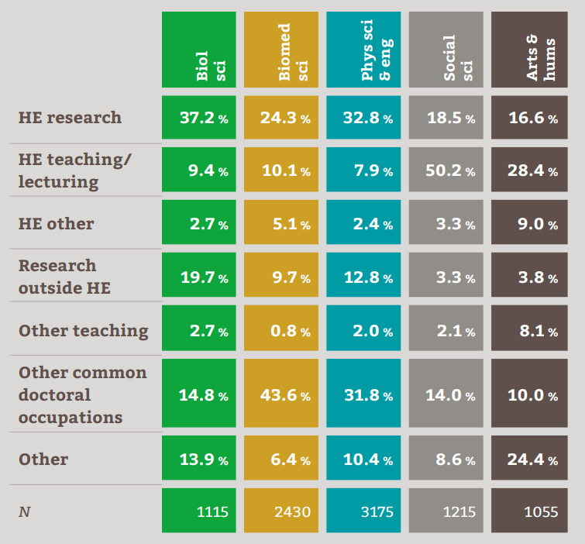
Note: the significant variation of PGR ‘destinations’ depending on subject area…
Vote now…

Slide 10
QUIZ TIME
Of those graduating in 2017-18, what percentage of Postgraduate Researchers were on a fixed-term (not permanent) work contract 15 months after graduation?
25%
40%
Vote now…

Slide 11
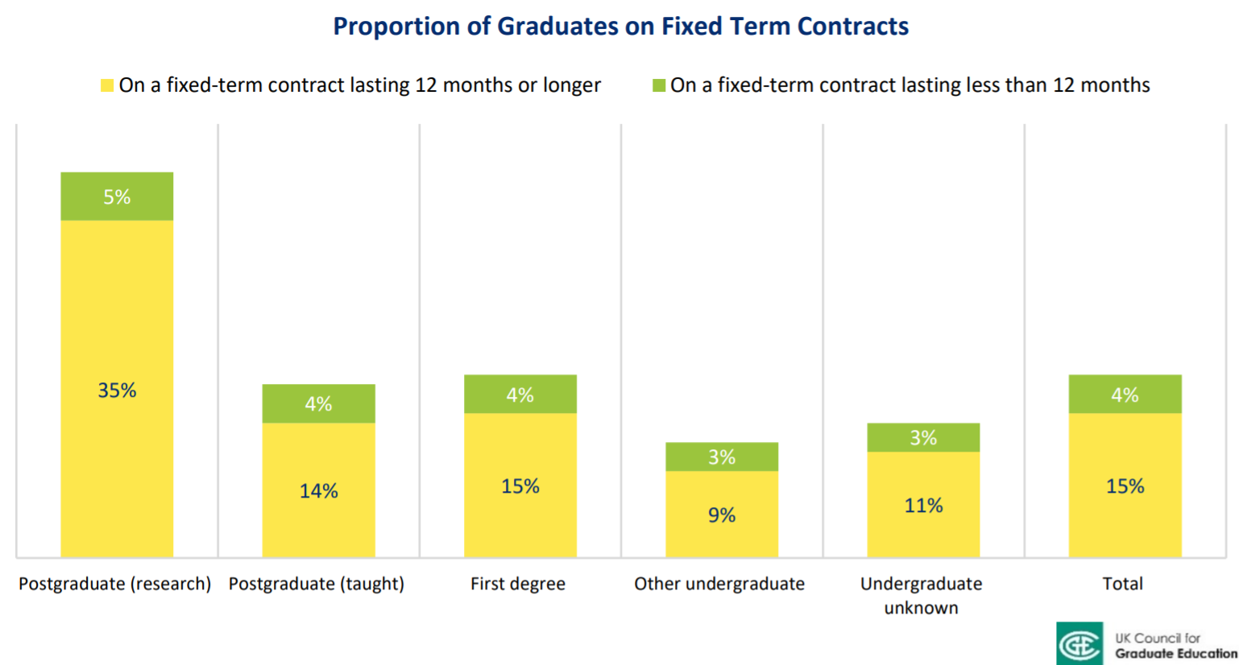
Vote now…
Vitae® © 2013 The Careers Research and Advisory Centre (CRAC) Limited: What do Researchers Do? (2013)
Notes:
UKCGE’s policy briefing following publication of the Graduate Outcomes survey for 2017/18 graduates: http://www.ukcge.ac.uk/article/graduate-outcomes-17_18-policy-briefing-464.aspx – a survey done across all grads 15 months afire graduation.
Now 40%... Not too dissimilar from the percentage who were still in HE. So perhaps this is influenced by the fact that a significant proportion of PGRs spend quite a while on fixed-term contracts if they are trying to advance in academia

Slide 12
QUIZ TIME
People with a postgraduate research degree are likely to earn more than graduates with a taught Masters degree…
True
False
Vote now…

Slide 13
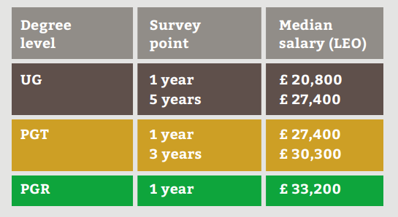
Vote now…
Notes:
13:30 – any questions?
LEO = longitudinal educational outcomes
So, we’ve seen there that many PhDs work outside academia. The further out from the PhD, the more likely they are to move into a different sector. More are likely to spend time in fixed-term contracts after graduation… but overall we see PhDs earning higher median salaries 1-10 years out of graduation than those with a Masters degree. That of course will vary depending on subject area and the sector they work in.

Slide 14
PROS AND CONS
‘Time out’ of the labour market/ earning
Can be lonely at times (if you don’t capitalise on social/ networking opps.)
Feeling like your work is never ‘done’
Much rests on your relationship with your supervisor!
Convincing prospective employers you aren’t just focused on one niche area
Quite likely to ‘catch up’ over time
Pursue your interests, which could lead you to future options
Intellectual satisfaction
Doing something new/ innovative
Other skills, e.g. problem solving, analytical skills (and potentially chances to get other experience, work with industry partners etc.)
Vote now…
Notes:
Start 2:40 So, we can see there that in terms of life after PhD, there might potentially be some shorter-term draw backs but longer term gains. With that in mind… I want us to now think about what we think might be some of the main pros and cons of doing a PhD. So, again, I’m going to give you 45 seconds to type your thoughts into the chat!
What do you think? Based on what we’ve talked about so far; motivations for a PhD, a few stats… what do you think are the pros and cons? In general… or for your personally?
‘Time out point’ – watching all your friends get jobs and mortgages as you’re still self-funding study/ on a stipend!

Slide 15
WHAT IS A PhD?
Notes:
Start this section 2:55
A few mins to have a think and post what you think!
https://padlet.com/h_prescott/what-does-a-phd-involve-giza1ti3lu2f

Slide 16
Research
- Fieldwork – interviewing people etc.
Lab work – setting up experiments, running experiments
Recruiting participants
Meetings with supervisors/ lab group
Collecting data
Interpreting results
Using archives
Reading: using the library a lot!
Writing
Editing
Other things
- Seminars and conferences
Organising conferences/ seminars
Writing articles/ publications
Teaching or demonstrating
Upgrade/ progress panels
Undertaking training
Bidding for funding
P/T work (?)
Liaising with industrial partners
Some CDT doctorates may have modules/ research skills training
Getting involved in for a & groups
Vote now…
Notes:
Any questions? Anything surprising there, or anything you were expecting that is missing?
Any questions at this point?

Slide 17
WHAT IS A PhD?
Carrying out a literature review (a survey of current relevant scholarship)
Deciding a methodology
Research design (designing experiments, surveys, fieldwork etc.)
Conducting original research and forming conclusions/ gathering results
Producing a thesis that presents your work and conclusions
Writing up your thesis and submitting it
Defending your thesis in an oral viva voce exam which assess what original contribution to knowledge your work has made
Vote now…

Slide 18
WHAT IS A PhD?
Research objectives explain what you are intending to achieve. You might use:
Research question(s)
Hypotheses: an assumed relationship between two or more variables
Propositions: testing statements that explain likely phenomena
Problem(s): identify and propose a solution
Your research question(s)/ objectives may change over time… that’s ok!
Vote now…

Slide 19
WHAT DOES IT TAKE TO DO A PhD?
Vote now…
Notes:
3:10pm
what skills and personal traits do you think you need? Tell us in the Padlet

Slide 20
Subject knowledge: modules relevant to the project | Relevant technical skills, lab techniques or methods | Research experience (lab project, dissertation, work experience)
Curious with a thirst for knowledge | Thorough | Independent thinker
Self-motivated, self-disciplined | Good at teaching yourself | Good concentration
Dedicated | Proactive | Good problem solving ability
Questioning | Driven | Resilient
Able to accept feedback and criticism | Organised | Willing to learn
Can admit mistakes | Adaptable | Confident
Vote now…
Notes:
Any questions?

Slide 21
IS IT FOR ME RIGHT NOW?
Notes:
3:20pm

Slide 22
ASK YOURSELF…
What do you want to do with the next 4/5… years of your life?
Explore ideas
Expand my career opportunities
Make money
I’m not sure
Do you have an idea of what area you would study for a PhD?
I have a clear idea
I have some ideas
Not really
Vote now…
Notes:
‘Last one standing!’

Slide 23
ASK YOURSELF…
How excited are you by the ideas you have for your PhD area?
Very
Fairly
Not very
I’d rather watch Netflix…
Do you need to do a PhD to pursue these ideas/ interests?
Yes
I don’t know
Maybe not
No
Vote now…
Who is still standing…?!?
Inspired by Berdahl & Malloy: Work your Career (2018)
Notes:
‘Last one standing!’
These are based on a flow diagram from Work Your Career. This is important because it shows some important motivations and things that ideally you need in place before seriously considering a PhD:
What you want from the next few years of your life (and if a PhD is compatible with that)
Clarity around research topic – what you want to look at and why this is important. This will really help you connect with potential supervisors (not just as someone who will apply for any PhD without outing in some thought)
Interest and motivation towards that topic: crucial part of your application
Whether a PhD is the way to do what you want to do, or whether there are other options to consider. And if you don’t know the answer to questions 4… find out!!

Slide 24
WHY IS THIS IMPORTANT?
Project: clearly-outlined; feasible; positions itself within/alongside existing scholarship and displays an original contribution to knowledge
Person: what makes you the best person to undertake this research?
Preparation: What relevant experience do you have (relevant modules, dissertation, research skills courses etc.)?
Place: Why are you applying to that University/ Department? Your fit with existing research interests, resources available, evidence that appropriate qualified supervisors are available
Passion for your subject!
Vote now…
Notes:
You will find out more about the application process at the CSSW event tomorrow at 11am, but…

Slide 25
Ready to find out more?
Applying for and funding a PhD
15th November 14.00 – 15.30, online
The PhD application process;
The difference between applying for a pre-set project and applying for a project of your own creation;
Some of the different funding options available to you;
Any questions you might have about the application or funding processes.
Book here
Highlight something, add a call to action, or provide a link

Slide 26
NEXT STEPS
Discuss your options with a careers adviser by booking an appointment via Careers Connect: https://bham.targetconnect.net
Applying for PG Study and applying for funding: 2:00 – 3:30pm, Wednesday 15 November
Postgraduate Open Day: Saturday 25th November: https://www.birmingham.ac.uk/study/postgraduate/open-events/campus-event
Vote now…

Slide 27


Slide 28

URL: http://intranet.birmingham.ac.uk/careers/pg
Email: careersenquiries@contacts.bham.ac.uk

